Slide 1
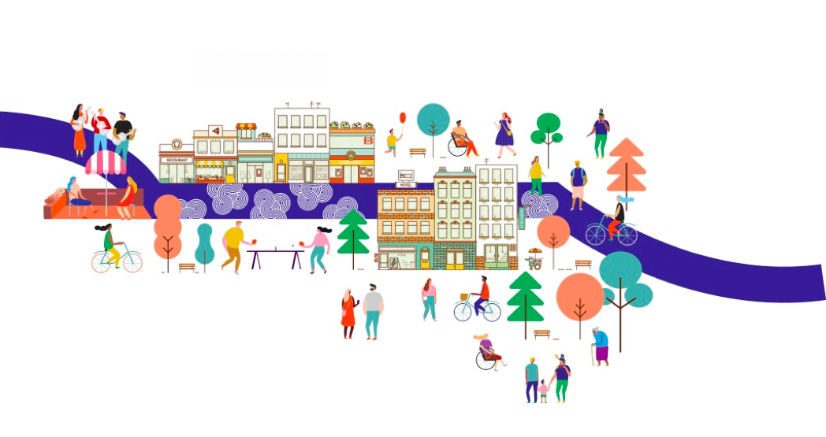
Rapid Placemaking to
Bring Back Main Street
Toolkit Activities!
CUI x Happy City
Webinar activity
These boxes provide instructions for completing the activity.

Slide 2
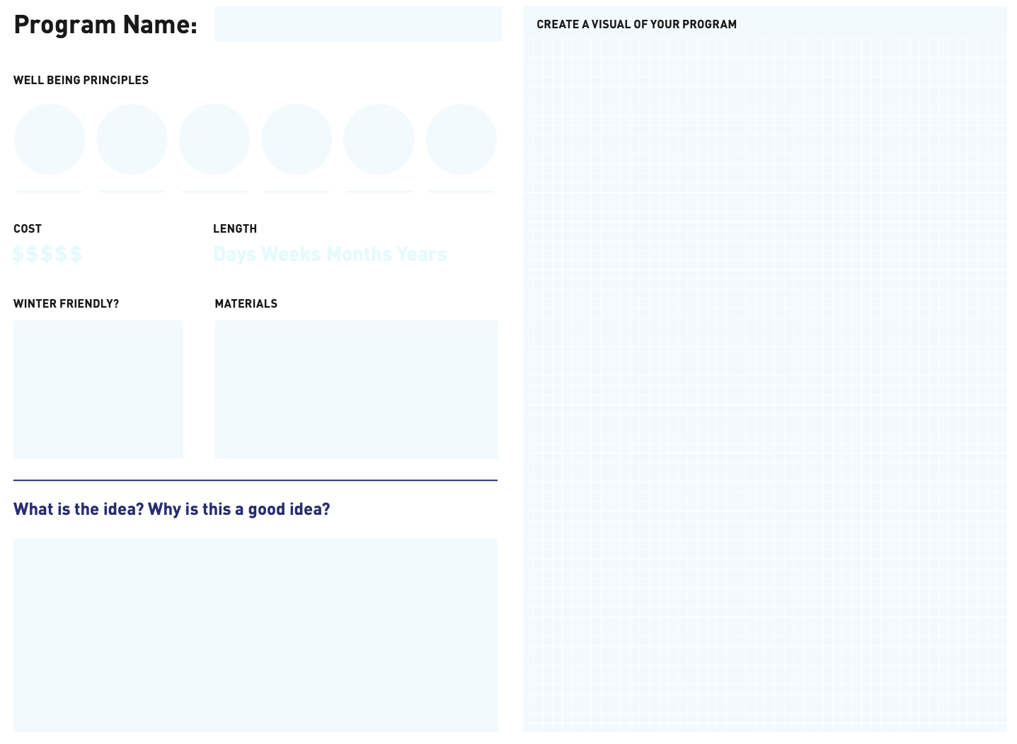
First, briefly introduce your idea. If it’s a programming idea, fill out this sheet. If it’s a design idea, move on to the
next slide.
You can copy and paste a sketch, an image from the internet, or words that help you paint a picture of your idea.

Slide 3
If your idea is a
design intervention,
fill out this sheet.
You can copy and paste a sketch, an image from the internet, or words that help you paint a picture of your idea.
Cost
Length
Is it winter friendly?
Materials

Slide 4
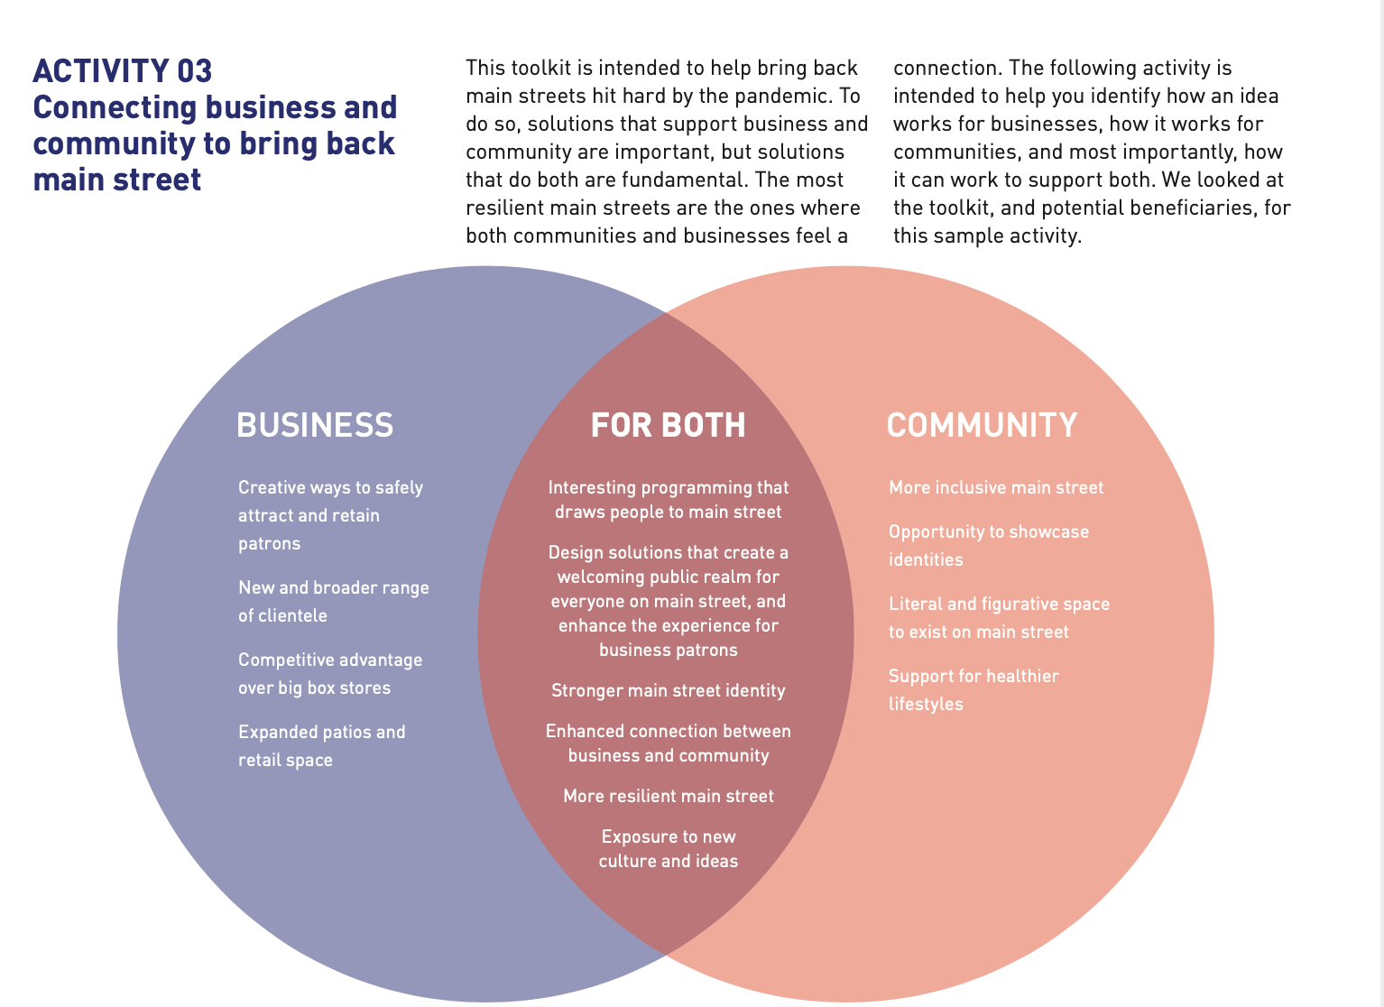
Read this, to help you understand the activity on the next slide.

Slide 5
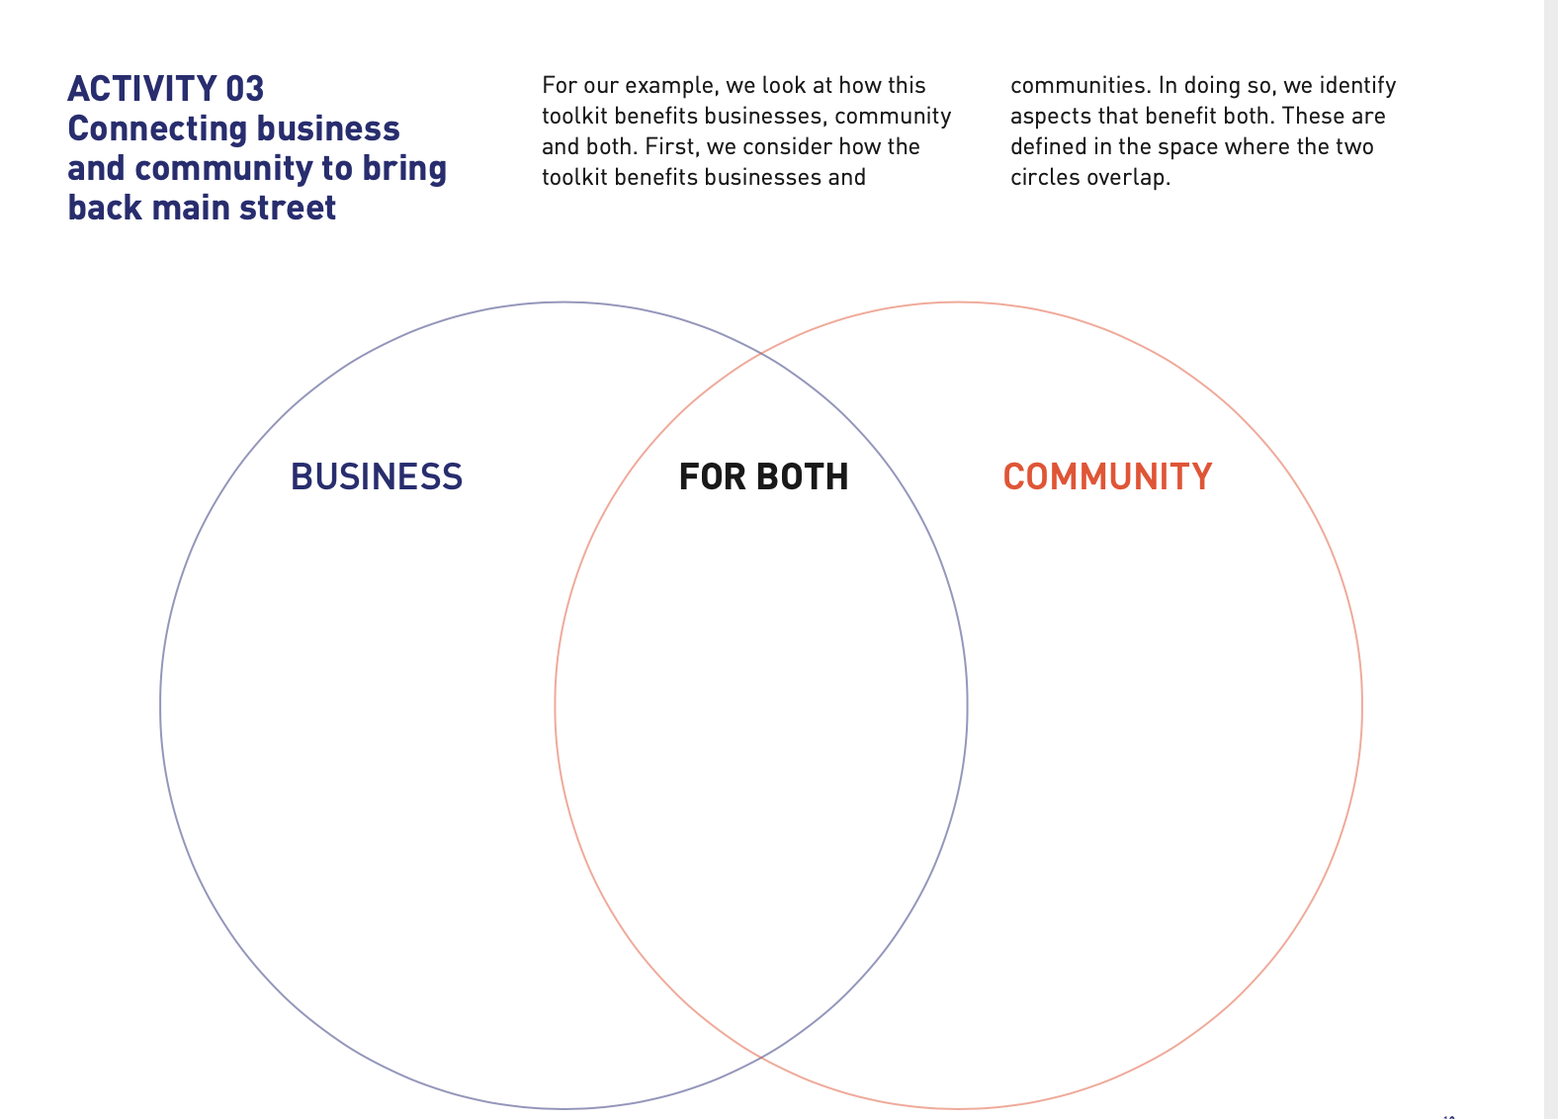
Whether you are sharing a programming idea or design intervention ideas, fill in the circles in a way that makes sense for your idea, community & local business.

Slide 6
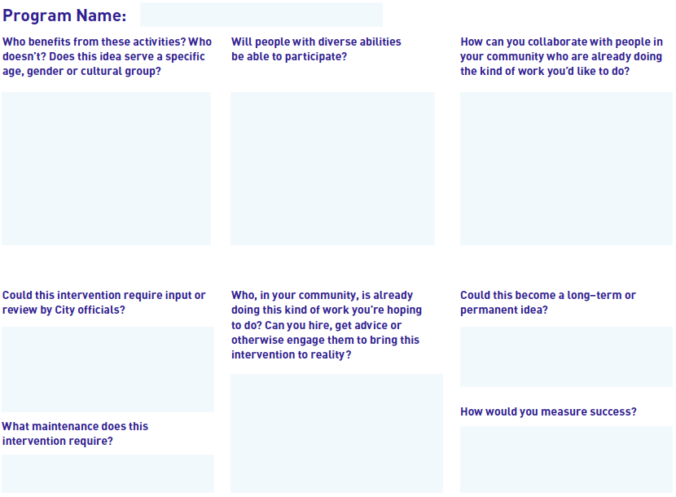
Fill this in if your idea is a programming idea. If it’s a design idea, move on to the
next slide.

Slide 7
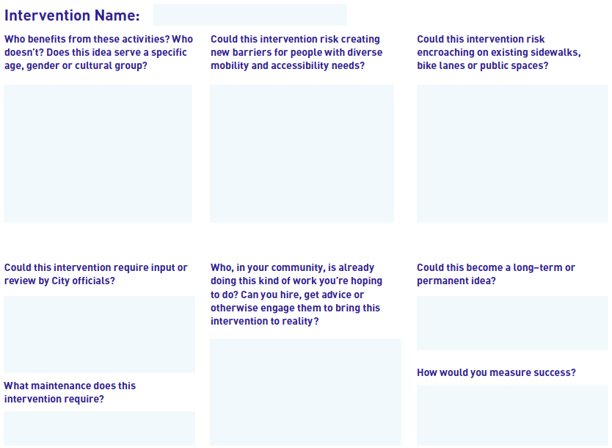
Fill this in if your idea is a design intervention idea.

Slide 8
Thank you!
See you at the webinar!

